Slide 1
Survival Analysis
Evan Boyd, Lev Tyomkin, Kelley Monzella, Nic Carlson
LT

Slide 2
Agenda
Introduction to survival analysis
Review of most commonly referenced models
Cox Proportional-Hazard Model deep dive
Example in R
Conclusions and questions
LT

Slide 3
Introduction into survival analysis
LT

Slide 4
These methods are being applied in many fields
When/
How long?
Customer analysis
Predictive maintenance
While origins of survival analysis are in medical research
Does treatment matter?
Insurance risk analysis
Lifespan of employees / clients
LT

Slide 5
Review of common models and terms
LT 60 seconds in

Slide 6
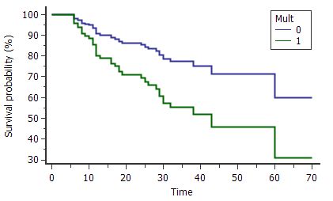
Example study output and design
Event
Time/Scale
Event/Censored
Event happens (i.e. 'failure')
Defined starting point
Time occurs
Event doesn't happen (e.g. censored)
Measured across different treatment groups
Borrowed from: https://www.medcalc.org/manual/cox_proportional_hazards.php
LT
Notes:
Kaplan Meier; Stepwise
Graph shows probability at specific points
Downside is that you can't pull derivatives at any point
Doesn't support multiple linear regression

Slide 7
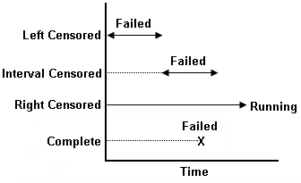

Censorship is an important component to Survival analysis
Variable | Description
Censorship | Event hasn't happened to subject by end of study Right-censored data always included in data Left and interval censored data may be omitted
Cause of censor
Failure between time zero and an unknown time
Failure between regular inspection (e.g. every 100 hours)
No event by exit (remember study length is fixed)
Sources: 1. https://help.xlstat.com/s/article/what-is-the-difference-between-a-parametric-and-a-nonparametric-test?, 2. https://towardsdatascience.com/survival-analysis-intuition-implementation-in-python-504fde4fcf8e, http://help.synthesis8.com/weibull_alta8/data_types.htm
LT

Slide 8
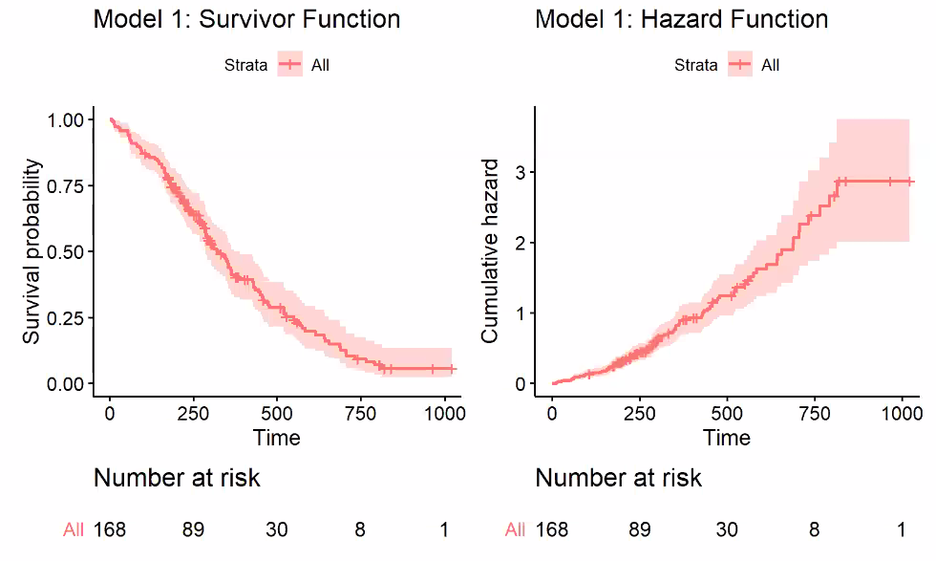
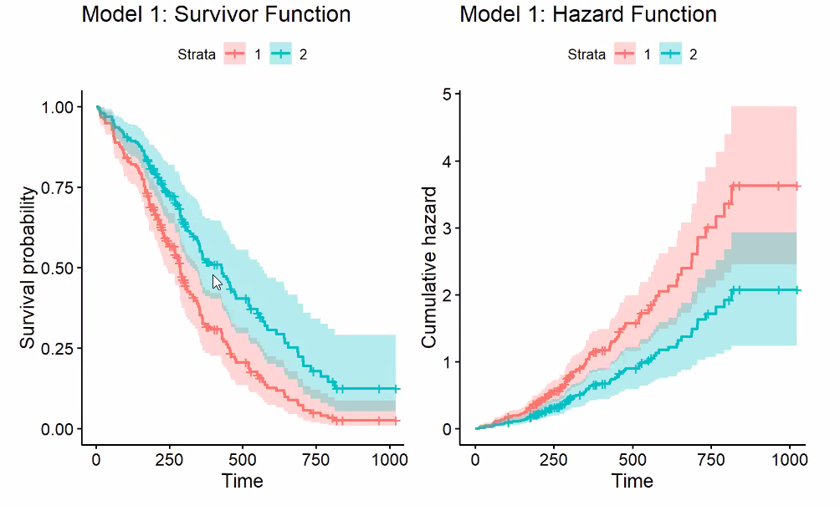
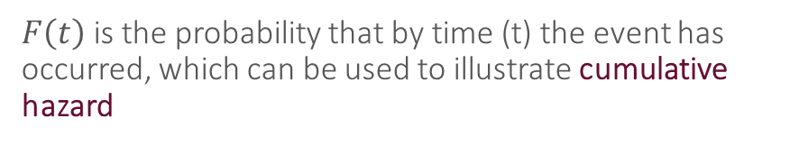
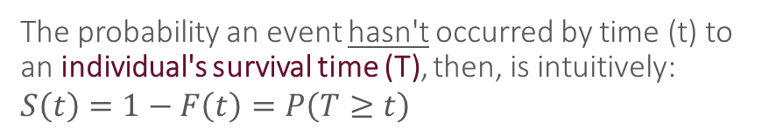
Mathematical intuition of survival analysis
Cumulative Hazard function
Survivor Function
$F\left(t\right)$ is the probability that by time (t) the event has occurred, which can be used to illustrate cumulative hazard
The probability an event hasn't occurred by time (t) to an individual's survival time (T), then, is intuitively:
$$S\left(t\right)=1−F\left(t\right)=P\left(T≥t\right)$$
EB
Notes:
For hazard – The slope. Hazard at any point (t) given you're alive. While time increases, risk of event happening to you increases
For survivor – hile time increases, probability of event happening decreases
Survivor example: what's the probability an individual survives $≥$ 2 months?

Slide 9
Cox Proportional-Hazard Model Deep Dive
EB 4 min in

Slide 10
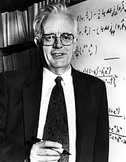
While several models exist, Cox Proportional-Hazards Model is most widely applied
Sir David Cox
distinguished models for continuous time
[Co]authored >300 papers/books
Developed Proportional-Hazard Model in 1972
Knighted in 1985 for efforts
Several models developed since based on Cox's model
Kaplan-Meier Estimate (1958): A non-parametric model that takes a binary input and typically only used for single-group analysis
Cox Model (1972): A semi-parametric model similar to Kaplan-Meier; includes static covariates with a multiplicative relationship to time (therefore no correlation with time)
Aalen – Cox model (1980): A non-parametric counterpart to the Cox Model that assumes covariates may change over time
Sources: 1. http://www.ukm.my/jsm/pdf_files/SM-PDF-46-3-2017/15%20Aditif%20Aalen.pdf, 2. http://sphweb.bumc.bu.edu/otlt/MPH-Modules/BS/BS704_Survival/BS704_Survival6.html
EB
10

Slide 11
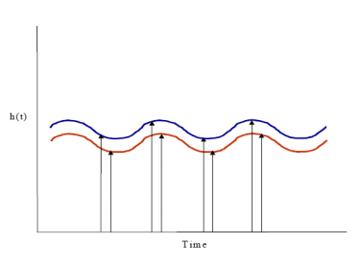
Assumptions of Survival analysis
Individuals and events are independent¹
Subjects should not be censored for reasons related to the study¹
Covariates should not change over time
Hazard ratio is constant over time
Also applicable to other survival models
Sources: https://www.ncbi.nlm.nih.gov/pmc/articles/PMC3275994/; https://www.pharmasug.org/proceedings/china2018/SP/Pharmasug-China-2018-SP75.pdf
NC
Notes:
Thanks Evan, before we dive into the actual Cox Proportional Hazard model itself, I'll walk through a few assumptions that the model follows:
First, Individuals and events are independent from each other. Assuming Evan and I are both subjects in the lung cancer study, my survival is not dependent upon Evans, and his death, though I would mourn it, it shouldn't mean I'm going to die shortly after
Second, subjects should not be censored for reasons related to the study. An example of this is if a participant is lost or censored because they're too ill to respond. If this happens frequently, you can see how it would skew the results. On the other hand, it shouldn't influence your results if subjects are lost/censored for reasons unrelated to the study - for example: maybe they die of other causes, maybe they finish the study period without the event observed, or just decide they don't participate anymore.
Third, covariates should not change over time. If you started a study in age group 1 or as a smoker, you stay in those groups throughout the course of the study. Important to define at beginning of study. We'll see an example of this in our data. If you can't fix it using one of the methods we show, you may need to choose a different survival model, such as Aalen's Additive model.
Lastly, the hazard ratio is constant over time. For example, if this chart shows the difference in hazard for Females versus Males, the difference between their hazard of event x occurring should be the same as it is at time 1, time 2, time 3, etc.

Slide 12
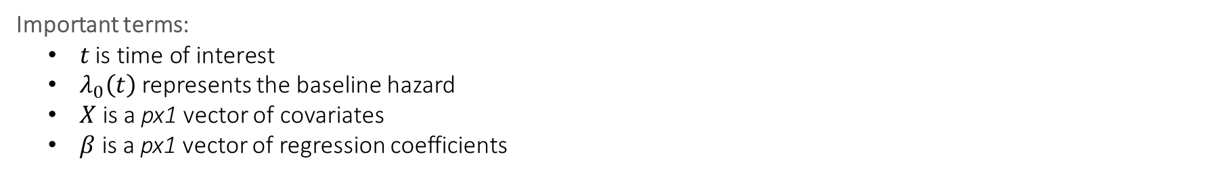
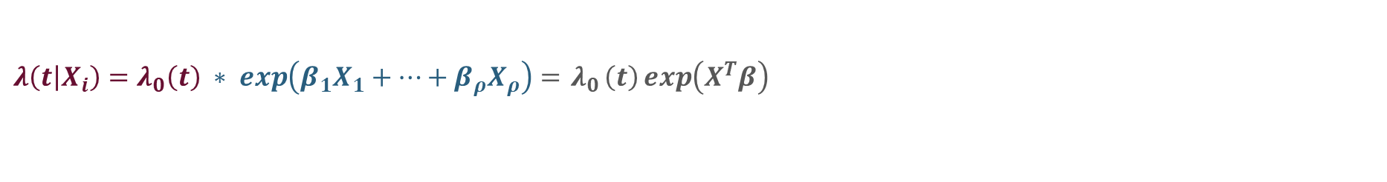
Cox Proportional Hazard Model
Important terms:
$t \text{is} \text{time} \text{of} \text{interest}$
$λ_{0}\left(t\right)$ represents the baseline hazard
$X$ is a px1 vector of covariates
$β$ is a px1 vector of regression coefficients
What are we actually estimating?
$$λ\left(\left.t\right|X_{i}\right)=λ_{0}\left(t\right) ∗ exp\left({β_{1}X}_{1}+…+β_{ρ}X_{ρ}\right)={ λ}_{0}\left(t\right)\exp\left(X^{T}β\right)$$
Baseline Hazard
exponentiated linear
combination of
covariates
Estimates
Defines the structure of how the baseline hazard function changes
Sources: http://www.ukm.my/jsm/pdf_files/SM-PDF-46-3-2017/15%20Aditif%20Aalen.pdf
NC
Notes:
Alright, so let's actually dive into the model.
We'll start by defining our terms:
Just as before, t is time of interest
λ₀(t) is a nonnegative function called the baseline hazard,. It represents the rate of hazard assuming all predictors are set to zero. Important note is that we don't actually know what the baseline hazard is since we won't ever observe coefficients set to zero
X is our vector of covariates
$β$ show change in expected log of the hazard ratio relative to a one unit change in X₁, assuming other predictors are constant
Looking at our actual model equation now, we see that it's simply our baseline hazard multiplied by our exponentiated linear combination of covariates.
The covariates define the structure that essentially adjusts our baseline hazard for each subject
When you use this model, you end up with your estimates.
Now, you can see that this model falls within the exponential family because is uses a log link function. Pretty neat.
Ok, so what are we actually estimating?

Slide 13
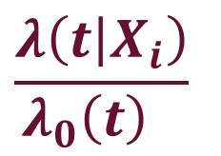

Called 'proportional hazard' because it estimates ratio of hazard with treatment against baseline
Proportional Hazard
INTERPRETATION
<1:
Lower risk
than base
~1:
No significant effect
>1:
Higher risk than base
$$\frac{λ\left(\left.t\right|X_{i}\right)}{λ_{0}\left(t\right){ }}{ }$$
Hazard with treatment
$$=$$
Baseline hazard
(or another group's hazard)
Sources: https://stats.stackexchange.com/questions/83892/understanding-coxph-output-in-r/285748#285748
NC
Notes:
The proportional hazard!
Essentially, this is the bread and butter of this model.
It allows you to compare a group or subject of interest against the baseline.
[click]
Additionally, you can compare two different groups to understand whether one is at more risk than the other.
[click]
This can be interpreted as follows:
A value <1 shows lower risk than the baseline
at or around 1 shows that the coefficients have little effect compared to the baseline hazard
And >1 illustrates higher risk than the baseline
Now that we know the importance of these betas, we need to find the maximum likelihood estimators

Slide 14
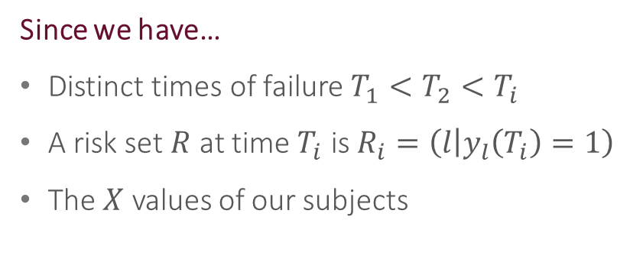

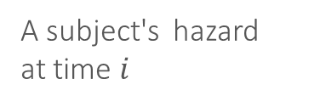
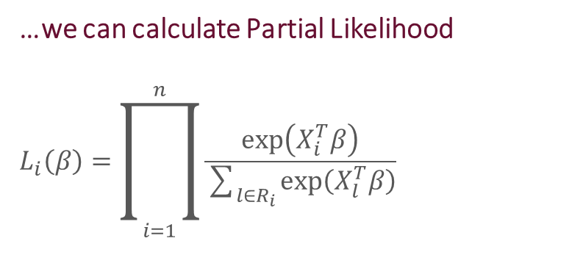
In the Cox Model, inference is based on maximum partial likelihood
As with other models, we seek to estimate the value of $β$ that maximizes $L\left(β\right)$, in other words, $\hat{β}$
Since we have…
Distinct times of failure $T_{1}<T_{2}<T_{i}$
A risk set $R$ at time $T_{i}$ is $R_{i}=\left(\left.l\right|y_{l}\left(T_{i}\right)=1\right)$
The $X$ values of our subjects
…we can calculate Partial Likelihood
$$L_{i}\left(β\right)=\prod_{i=1}^{n}{\frac{\exp\left(X_{i}^{T}β\right)}{\sum_{l∈R_{i}}{\exp\left(X_{l}^{T}β\right)}}}$$
A subject's hazard at time $i$
$$=$$
Sum of likelihood of remaining risk set
Sources: 1. http://www.ukm.my/jsm/pdf_files/SM-PDF-46-3-2017/15%20Aditif%20Aalen.pdf
NC
Notes:
As with other models, we want to estimate the value of $β$ that maximizes $L\left(β\right)$, in other words, $\hat{β}$
However, since we don't actually know the baseline hazard, ordinary likelihood methods can’t be used to estimate our betas.
Consequently, Cox uses a partial likelihood to remove the nuisance parameter, the baseline hazard, from our estimation equation. It allows us to depend only on β, the parameter of interest.
[click]
Since we have distinct times of failure, a risk set, which is the number of people not yet censored, and the X values, we can calculate partial likelihood as follows.
[click]
Each term in the partial likelihood formula is the conditional probability of choosing individual i to fail from the risk set, given the time and given that one failure is to occur.
This allows us to approximate the likelihood estimate for this model despite the constraints.
And with that, I'll pass it over to Lev

Slide 15


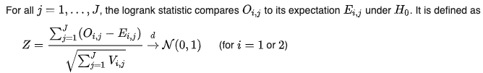
Determining goodness of fit
Log-rank Test
Interpretation
Nonparametric hypothesis test used to compare survival dists. of two samples
Score test for Cox proportional hazards model to compare two groups
Asymptomatically equivalent to likelihood ratio test statistic for Cox PH
Low
P-Value
High
P-Value
Reject null hypothesis
(that they have the same hazard function)
Fail to reject null hypothesis
LT
Notes:
The null hypothesis is that the two groups have identical hazard functions
Under Ho for each group i = 1, 2, 0ij follows a hypergeometric distribution with parameters Nj, Nij, Oj. The distribution has expected value above and variance above
For all j = 1,..., J, the logrank statistics compares Oij to its expecations under Ho. Defined as Z
By the central limit theorem, the distribution of Z converges to that of a standard normal distribution as J approaches infinity and therefore can be approximated by the standard normal distribution for a sufficiently large J. An improved approximation can be obtained by equating this quantity to Pearson type I or II (beta) distributions with matching first four moments, as described in Appendix B of the Peto and Peto paper.
.

Slide 16
Assessing the validity of a Cox Model
We test the various assumptions to determine how well our model fits the data
Testing proportional Hazards assumption
Validated when we see non-significant relationship between residuals and time
Look for random pattern in residual plot against time
Testing effect of influential observations
We can visualize either the deviance residuals or the dfbetas values
Testing non-linearity
Confirm that our continuous variables have a linear form
LT
Notes:
Source http://www.sthda.com/english/wiki/cox-model-assumptions#testing-proportional-hazards-assumption

Slide 17
Example (switch to R Markdown

Slide 18
Unused Slides

